Slide 1
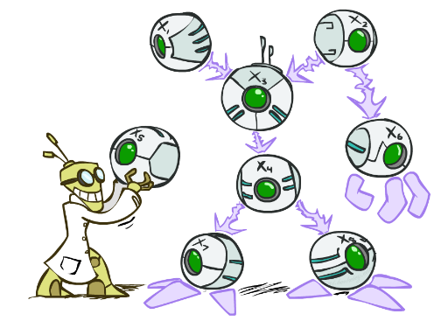
CS 188: Artificial Intelligence
Bayes’ Nets
Instructors: Dan Klein and Pieter Abbeel --- University of California, Berkeley
[These slides were created by Dan Klein and Pieter Abbeel for CS188 Intro to AI at UC Berkeley. All CS188 materials are available at http://ai.berkeley.edu.]
Notes:
Please retain proper attribution, including the reference to ai.berkeley.edu. Thanks!

Slide 2

Independence

Slide 3

Independence
Two variables are independent if:
This says that their joint distribution factors into a product two simpler distributions
Another form:
We write:
Independence is a simplifying modeling assumption
Empirical joint distributions: at best “close” to independent
What could we assume for {Weather, Traffic, Cavity, Toothache}?

Slide 4

Conditional Independence
P(Toothache, Cavity, Catch)
If I have a cavity, the probability that the probe catches in it doesn't depend on whether I have a toothache:
P(+catch | +toothache, +cavity) = P(+catch | +cavity)
The same independence holds if I don’t have a cavity:
P(+catch | +toothache, -cavity) = P(+catch| -cavity)
Catch is conditionally independent of Toothache given Cavity:
P(Catch | Toothache, Cavity) = P(Catch | Cavity)
Equivalent statements:
P(Toothache | Catch , Cavity) = P(Toothache | Cavity)
P(Toothache, Catch | Cavity) = P(Toothache | Cavity) P(Catch | Cavity)
One can be derived from the other easily

Slide 5

Conditional Independence
Unconditional (absolute) independence very rare (why?)
Conditional independence is our most basic and robust form of knowledge about uncertain environments.
X is conditionally independent of Y given Z
if and only if:
or, equivalently, if and only if

Slide 6
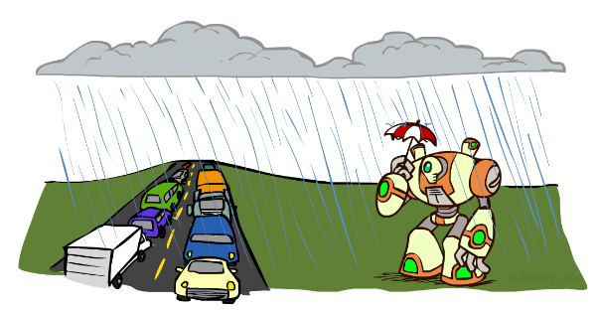
Conditional Independence
What about this domain:
Traffic
Umbrella
Raining

Slide 7
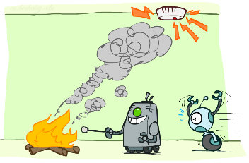
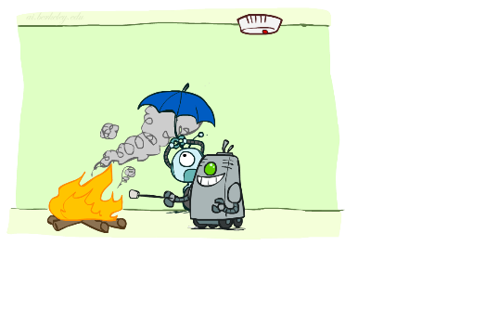
Conditional Independence
What about this domain:
Fire
Smoke
Alarm

Slide 8

Conditional Independence and the Chain Rule
Chain rule:
Trivial decomposition:
With assumption of conditional independence:
Bayes’nets / graphical models help us express conditional independence assumptions

Slide 9
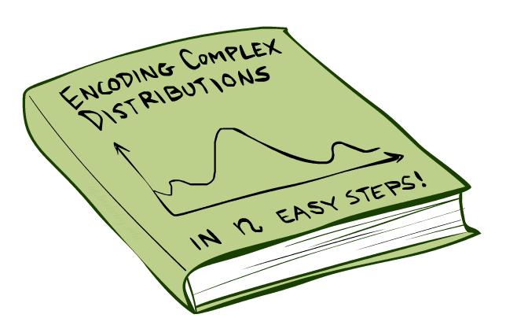
Bayes’Nets: Big Picture

Slide 10


Bayes’ Nets: Big Picture
Two problems with using full joint distribution tables as our probabilistic models:
Unless there are only a few variables, the joint is WAY too big to represent explicitly
Hard to learn (estimate) anything empirically about more than a few variables at a time
Bayes’ nets: a technique for describing complex joint distributions (models) using simple, local distributions (conditional probabilities)
More properly called graphical models
We describe how variables locally interact
Local interactions chain together to give global, indirect interactions
For about 10 min, we’ll be vague about how these interactions are specified

Slide 11
Example Bayes’ Net: Car

Slide 12
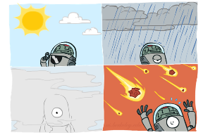
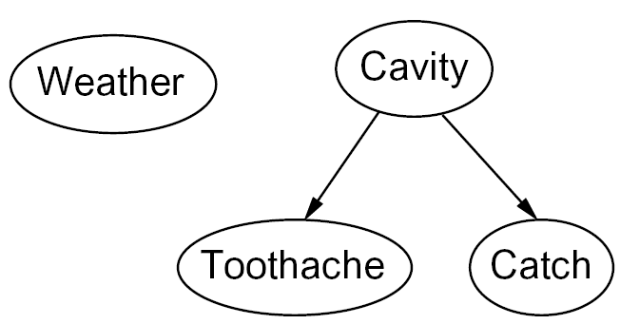

Graphical Model Notation
Nodes: variables (with domains)
Can be assigned (observed) or unassigned (unobserved)
Arcs: interactions
Similar to CSP constraints
Indicate “direct influence” between variables
Formally: encode conditional independence (more later)
For now: imagine that arrows mean direct causation (in general, they don’t!)

Slide 13

Example: Coin Flips
N independent coin flips
No interactions between variables: absolute independence
X₁
X₂
X_{n}

Slide 14
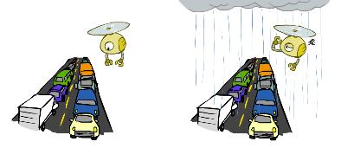
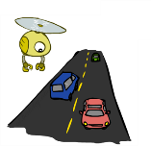
Example: Traffic
Variables:
R: It rains
T: There is traffic
R
T

Slide 15
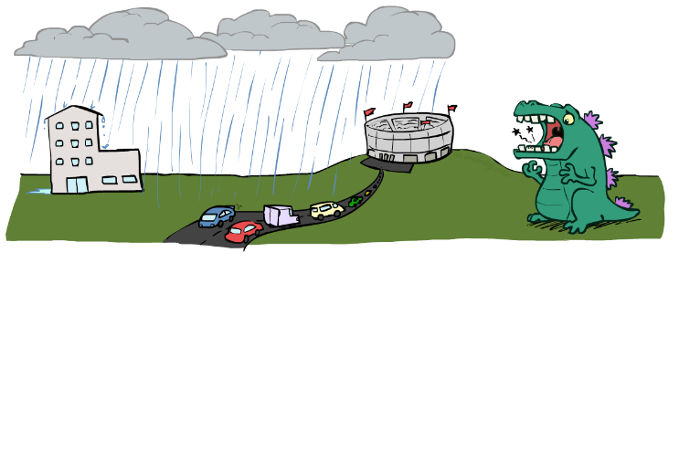
Example: Traffic II
Let’s build a causal graphical model!
Variables
T: Traffic
R: It rains
L: Low pressure
D: Roof drips
B: Ballgame
C: Cavity

Slide 16
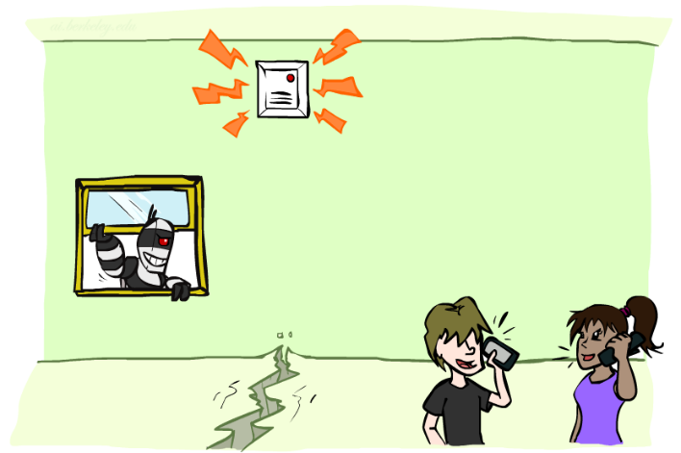
Example: Alarm Network
Variables
B: Burglary
A: Alarm goes off
M: Mary calls
J: John calls
E: Earthquake!

Slide 17
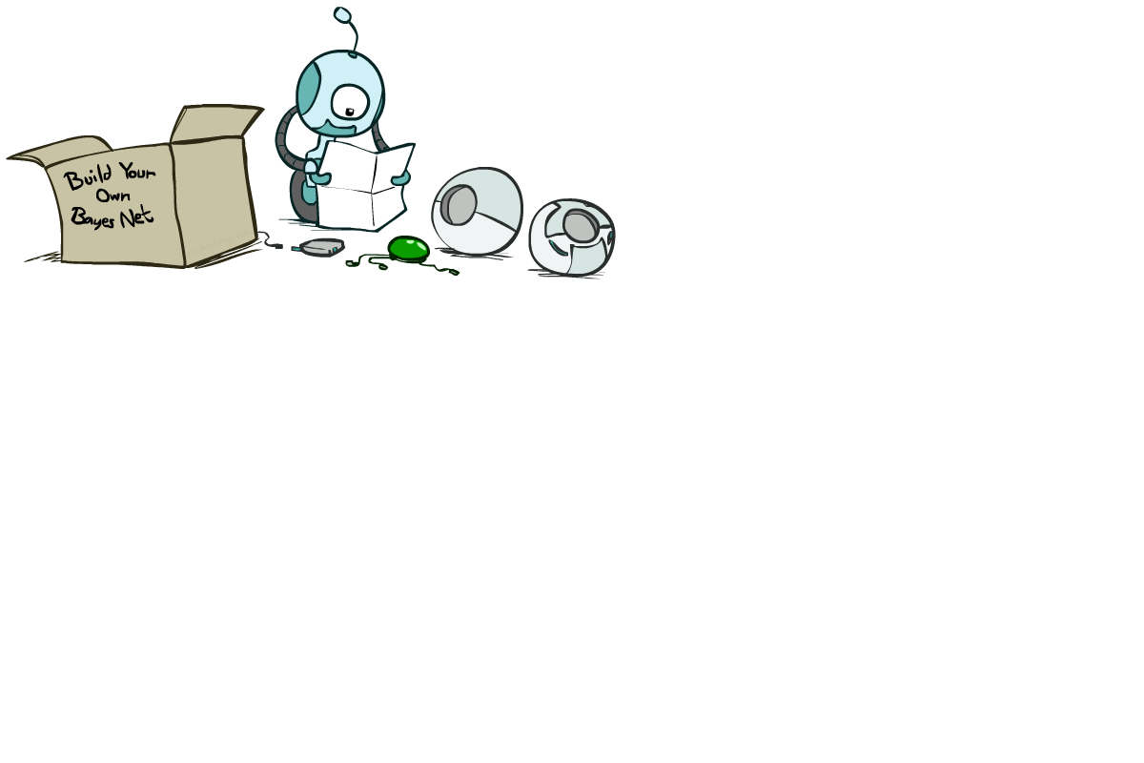
Bayes’ Net Semantics

Slide 18
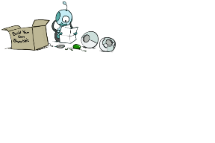


Bayes’ Net Semantics
A set of nodes, one per variable X
A directed, acyclic graph
A conditional distribution for each node
A collection of distributions over X, one for each combination of parents’ values
CPT: conditional probability table
Description of a noisy “causal” process
A₁
A_{n}
X
A Bayes net = Topology (graph) + Local Conditional Probabilities

Slide 19


Probabilities in BNs
Bayes’ nets implicitly encode joint distributions
As a product of local conditional distributions
To see what probability a BN gives to a full assignment, multiply all the relevant conditionals together:
Example:

Slide 20


Probabilities in BNs
Why are we guaranteed that setting
results in a proper joint distribution?
Chain rule (valid for all distributions):
Assume conditional independences:
→ Consequence:
Not every BN can represent every joint distribution
The topology enforces certain conditional independencies

Slide 21

Example: Coin Flips
X₁
X₂
X_{n}
h | 0.5
t | 0.5
h | 0.5
t | 0.5
h | 0.5
t | 0.5
Only distributions whose variables are absolutely independent can be represented by a Bayes’ net with no arcs.
Notes:
demo

Slide 22

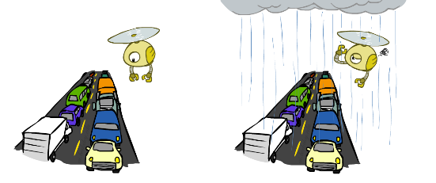
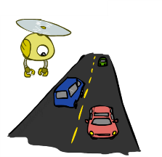
Example: Traffic
R
+r | 1/4
-r | 3/4
+r | +t | 3/4
 | -t | 1/4
T
-r | +t | 1/2
 | -t | 1/2
Notes:
demo

Slide 23
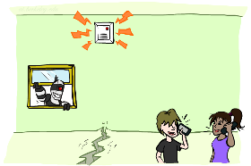
Example: Alarm Network
B | P(B)
+b | 0.001
-b | 0.999
E | P(E)
+e | 0.002
-e | 0.998
Burglary
Earthqk
Alarm
B | E | A | P(A|B,E)
+b | +e | +a | 0.95
+b | +e | -a | 0.05
+b | -e | +a | 0.94
+b | -e | -a | 0.06
-b | +e | +a | 0.29
-b | +e | -a | 0.71
-b | -e | +a | 0.001
-b | -e | -a | 0.999
John calls
Mary calls
A | J | P(J|A)
+a | +j | 0.9
+a | -j | 0.1
-a | +j | 0.05
-a | -j | 0.95
A | M | P(M|A)
+a | +m | 0.7
+a | -m | 0.3
-a | +m | 0.01
-a | -m | 0.99
Notes:
demo

Slide 24


Example: Alarm Network
B | P(B)
+b | 0.001
-b | 0.999
B
E
E | P(E)
+e | 0.002
-e | 0.998
A
A | J | P(J|A)
+a | +j | 0.9
+a | -j | 0.1
-a | +j | 0.05
-a | -j | 0.95
A | M | P(M|A)
+a | +m | 0.7
+a | -m | 0.3
-a | +m | 0.01
-a | -m | 0.99
B | E | A | P(A|B,E)
+b | +e | +a | 0.95
+b | +e | -a | 0.05
+b | -e | +a | 0.94
+b | -e | -a | 0.06
-b | +e | +a | 0.29
-b | +e | -a | 0.71
-b | -e | +a | 0.001
-b | -e | -a | 0.999
J
M
Notes:
demo

Slide 25

Example: Alarm Network
B | P(B)
+b | 0.001
-b | 0.999
B
E
E | P(E)
+e | 0.002
-e | 0.998
A
A | J | P(J|A)
+a | +j | 0.9
+a | -j | 0.1
-a | +j | 0.05
-a | -j | 0.95
A | M | P(M|A)
+a | +m | 0.7
+a | -m | 0.3
-a | +m | 0.01
-a | -m | 0.99
B | E | A | P(A|B,E)
+b | +e | +a | 0.95
+b | +e | -a | 0.05
+b | -e | +a | 0.94
+b | -e | -a | 0.06
-b | +e | +a | 0.29
-b | +e | -a | 0.71
-b | -e | +a | 0.001
-b | -e | -a | 0.999
J
M
Notes:
demo

